Slide 1

meetchewthere
Medium-Fi Prototype

Slide 2
FEED YOUR SOCIAL CRAVINGS
Notes:
Value prop

Slide 3

People CHOOSE Their Health or Their Social Lives
Socializing over meals can be complicated for people with dietary restrictions - so complicated that these people will do almost anything to avoid eating in social and uncontrolled settings. While some devise elaborate plans to make social eating work, most give up and isolate themselves from the world.
Notes:
Problem

Slide 4
They DON’T Have to Choose

Slide 5

meetchewthere
Notes:
meetchewthere redefines social eating for those affected by dietary restrictions by building trusted communities of geographically proximate people with common restrictions and provides a safe space to create, host, and join social events centered around food so that now the only choice to make is who to eat with!

Slide 6
Revised Interface
Major Design Changes
Notes:
Revised UI

Slide 7
Change 1
Observation(s):
Map-view paralysis
No use of search functionality
Analysis:
Content on Map vs List view was confusing
Unnoticed search bar in Map View
Search bar not valuable in List View
Solution:
Consistent Searchable/Filterable Homepage
Notes:
Home pages -> no map view, restaurant focused, filters, search . The list view seemes easier and more approachable so we decided to convey the same infonrmation that was in the map view in the list view. Two lists, one event focused , the other restaurant focused

Slide 8
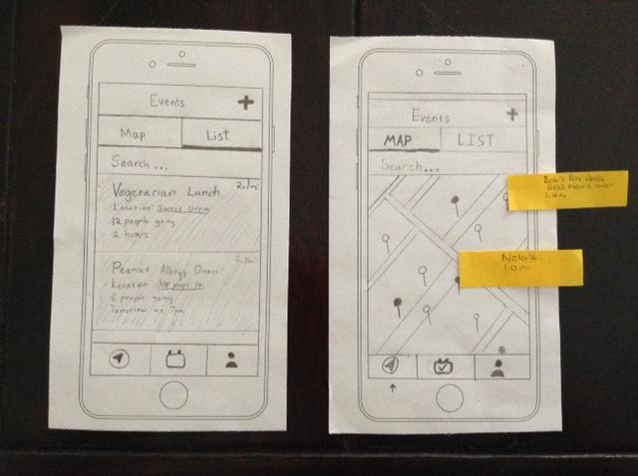
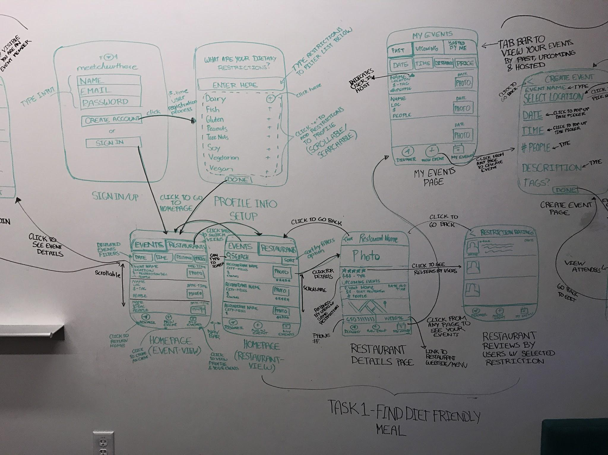
Change 1
Before
After
Notes:
Home pages -> no map view, restaurant focused, filters, search (automatically filtered by restriction)

Slide 9
Change 2
Observation(s):
Ongoing concern for safety
Desire to get others’ comments/advice
Analysis:
Necessary trust in our product was not established at the start
Users seek trust from others like them
Solution:
Improved On-boarding and Display of Relevant Info
Notes:
Building trust - restriction tags and ratings, relevant user reviews

Slide 10
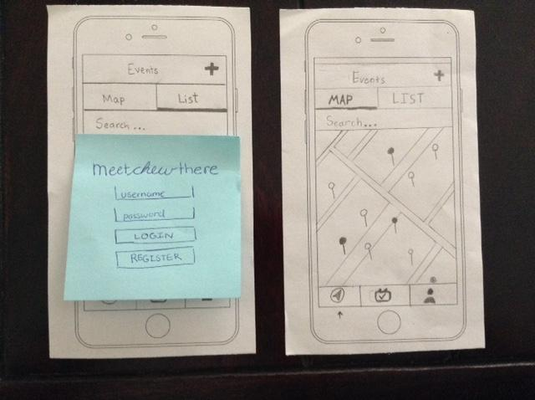
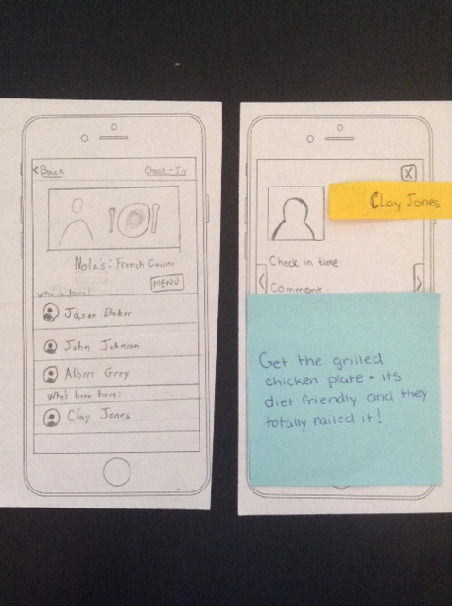
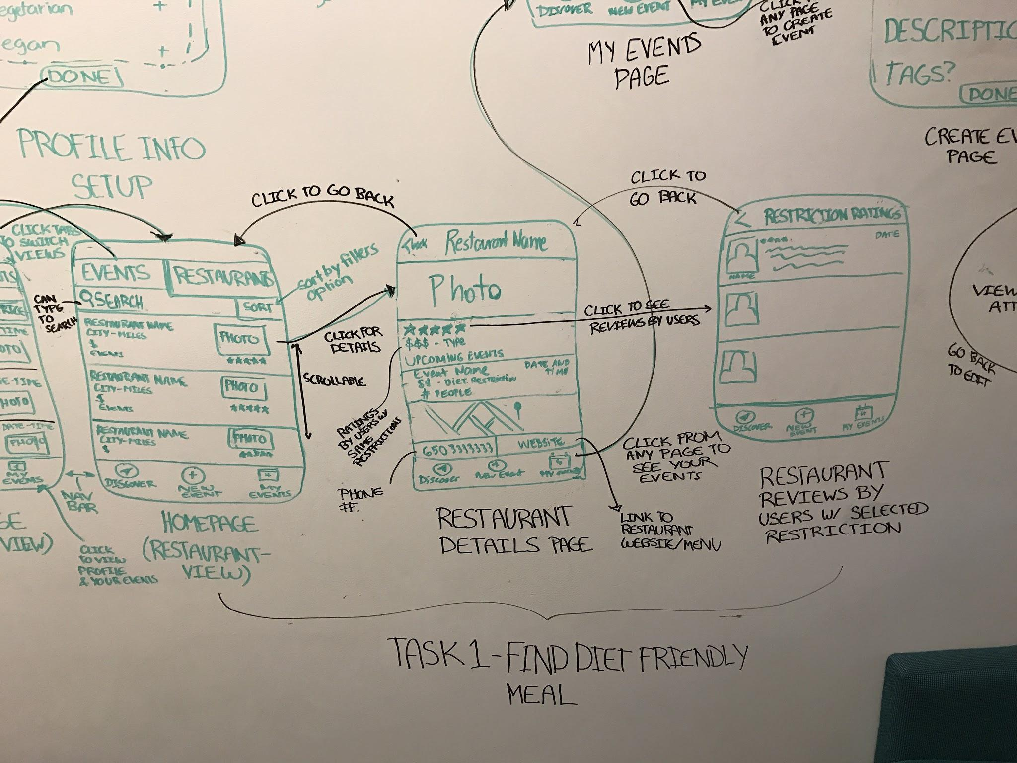
Change 2
Before
After
Notes:
Building trust - restriction tags and ratings, relevant user reviews

Slide 11
Change 3
Observation(s):
“Create Event” hard to find
Low-interest in non-restaurant events
Interaction with “My Events” Page
Analysis:
Unintuitive event creation process
Restaurants = less pressure, less planning, and no privacy concern
Desire to view “my events” with filters
Solution:
Streamline Event Management
Notes:
Managing events - more intuitive with nav bar, buttons clearly labeled, can see past, future and user owned, creation process streamlined - restaurant only (search to pick), then set date, time, number of people, and description). Interaction with my events page => they wanted it clickable

Slide 12
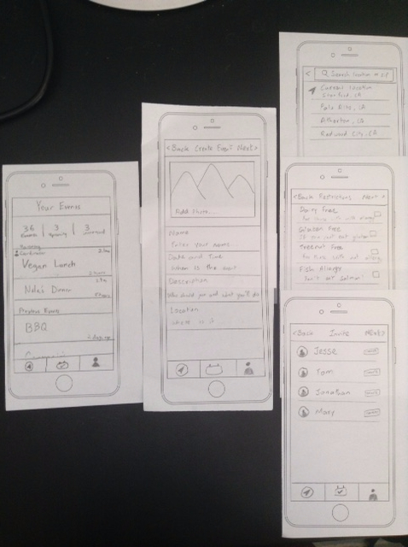
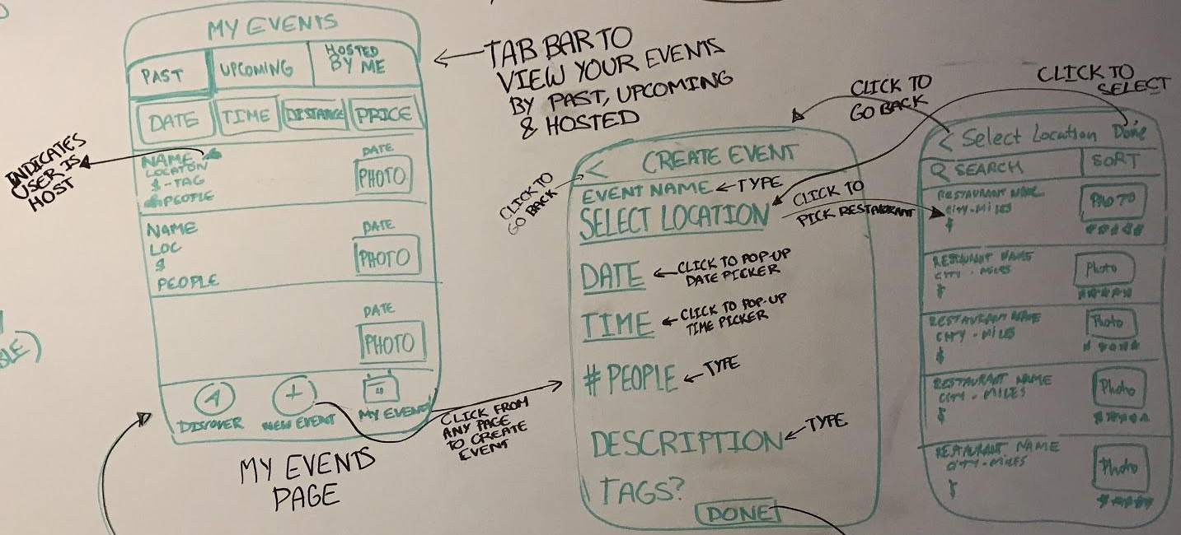
Change 3
Before
After
Notes:
Managing events - more intuitive with nav bar, buttons clearly labeled, can see past, future and user owned, creation process streamlined

Slide 13
Revised Interface
Task Flows

Slide 14
Simple Task
find a diet friendly place to eat
Notes:
Same as before. FIND FOOD

Slide 15
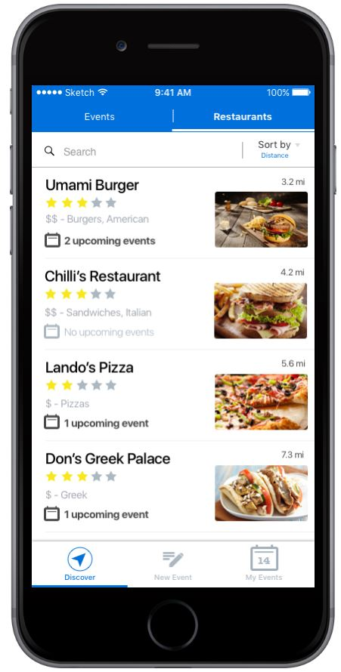
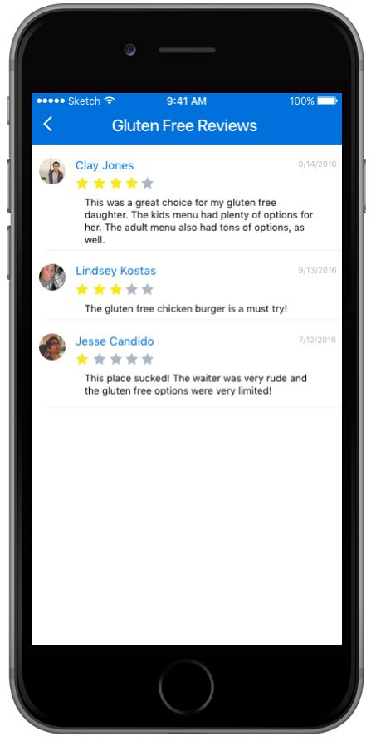
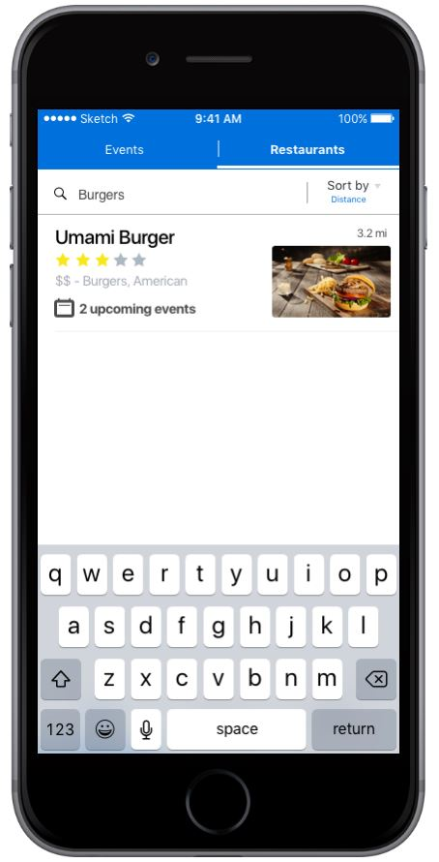
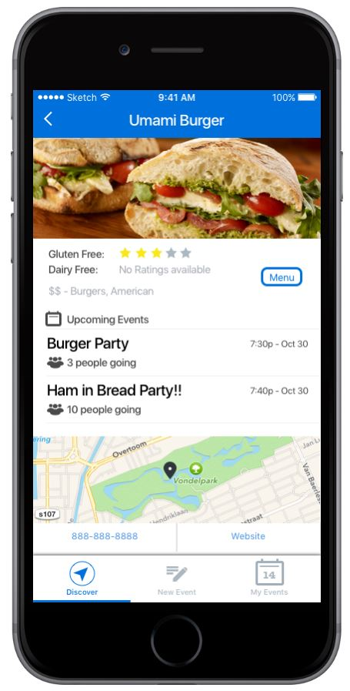
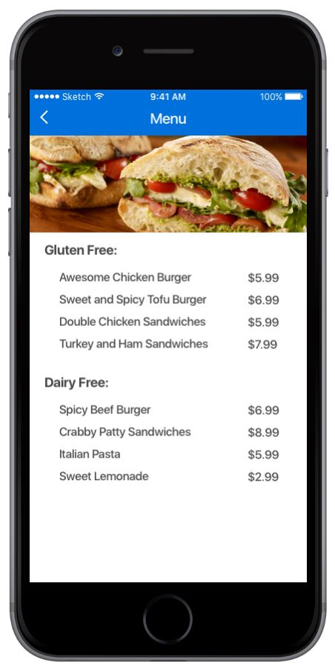
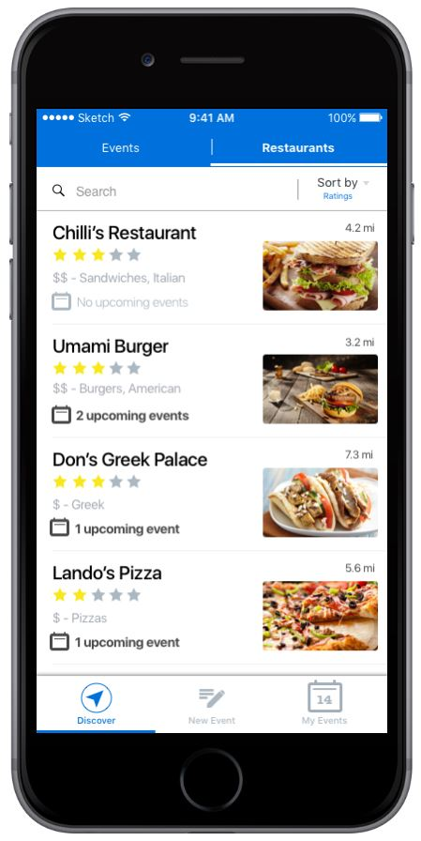
filter restaurants by distance, rating, and price or type a search
ratings/reviews are restriction specific and filtered based on user profile
menu shows restriction friendly options
restaurant website opens on a new page
navigate to the event details page for selected event
Notes:
Annotated screenshots of prototype

Slide 16
Moderate Task
join an event and share a meal with people with your same restriction(s) like you
Notes:
Changed from people with your like restriction to restricted people looking to eat socially (more general). Restriction can be rare, we dont want to limit people, selection process would occur naturally.FIND FOOD AND FRIENDS

Slide 17
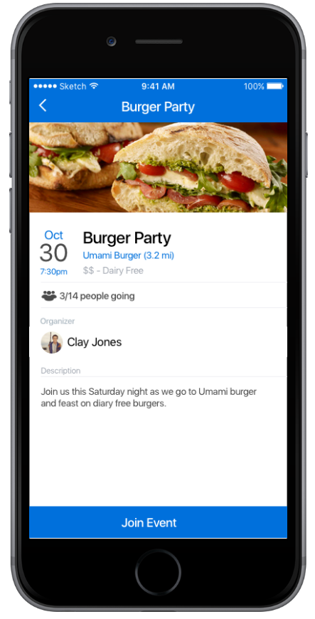
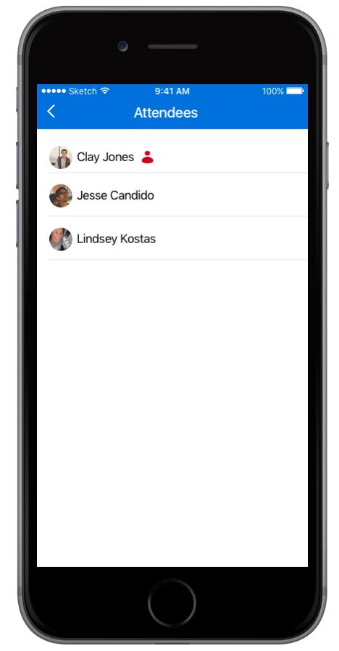
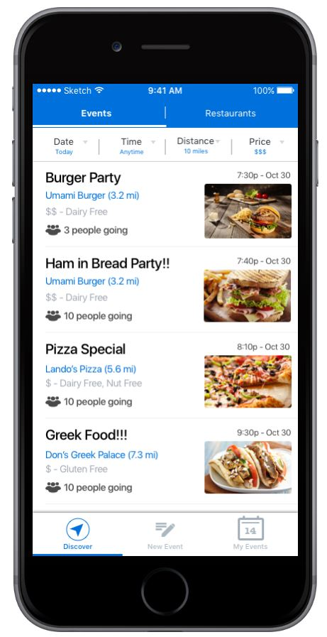
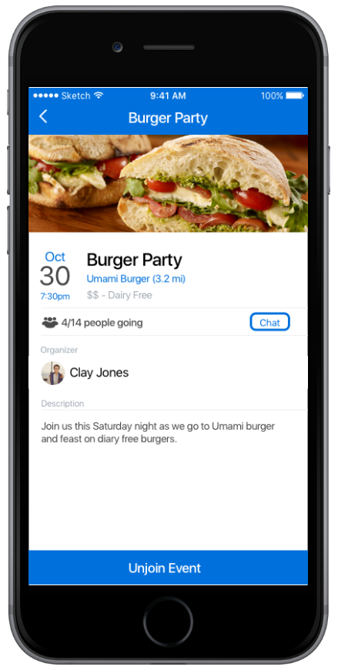
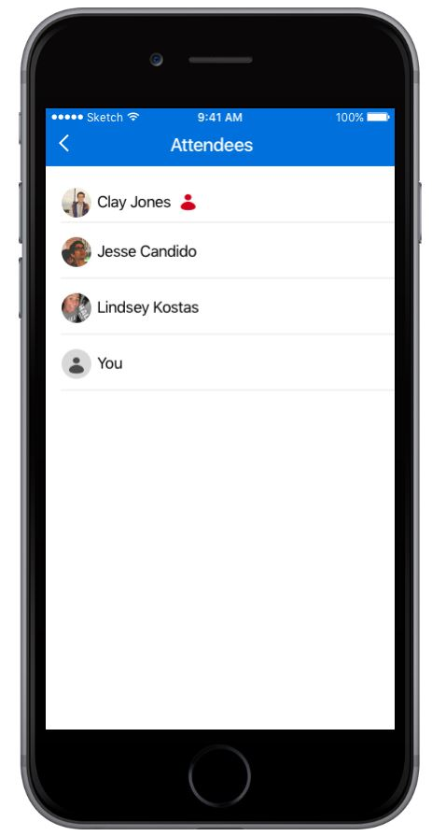
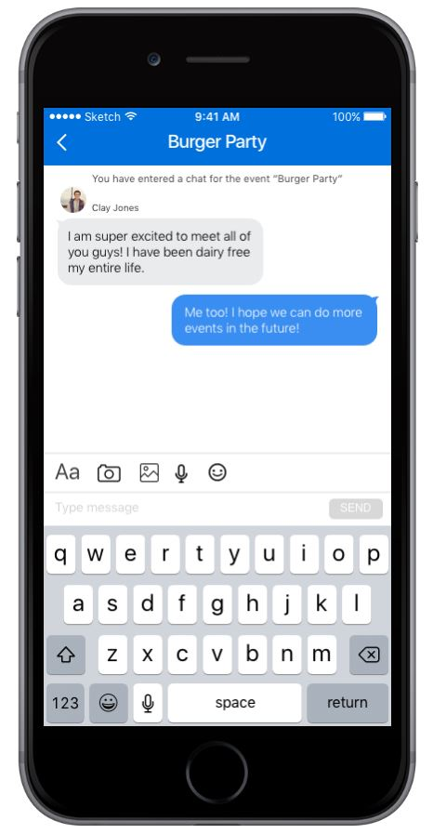
host denoted by figure
search for events by filter
navigate to restaurant details page to see more info (reviews, menu, address)
event specific group chat enabled only for event members
Toggle to restaurant search
join/unjoin at any time
Create an event or manage existing events at any time
Notes:
Annotated screenshots of prototype

Slide 18
Complex Task
complete the cycle, build your community, and create your own event
Notes:
Change to being restaurant based. LET FOOD AND FRIENDS FIND YOU

Slide 19
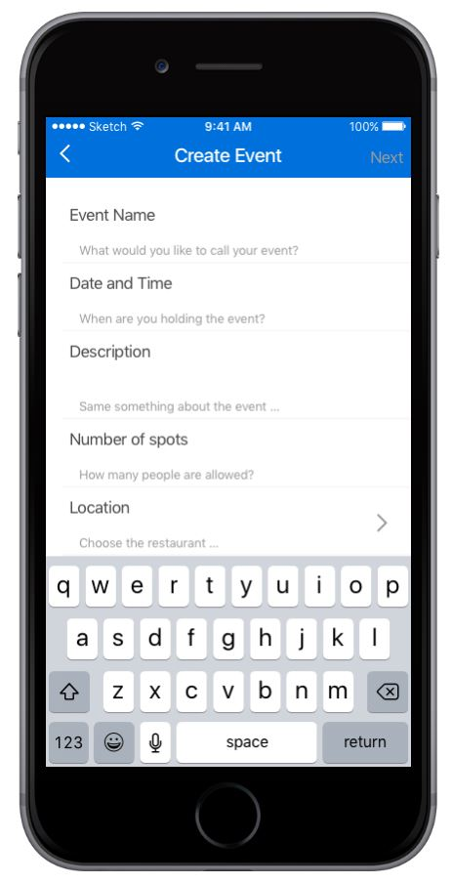
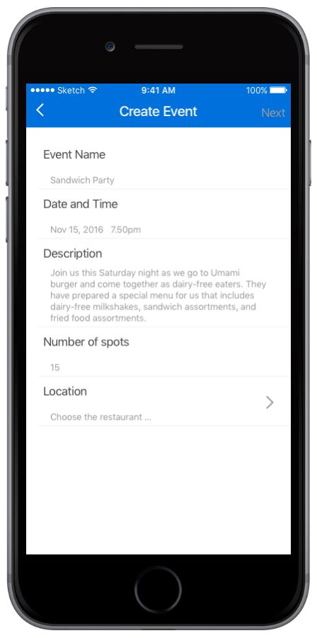
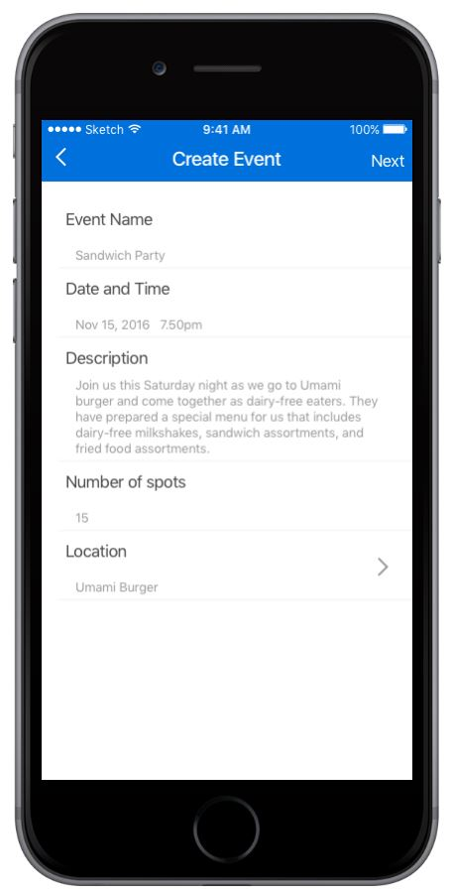
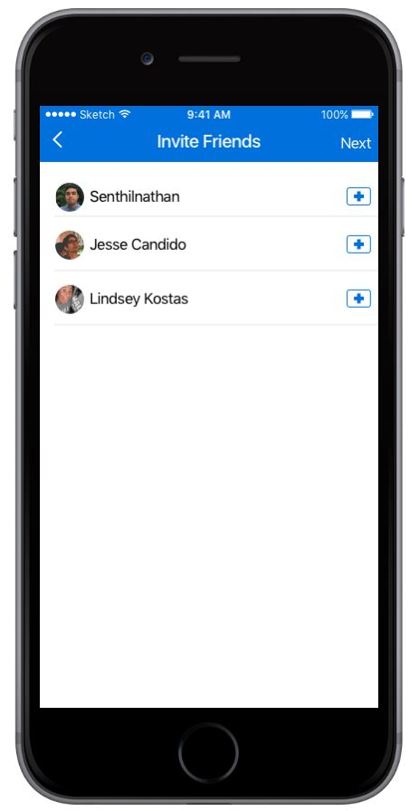
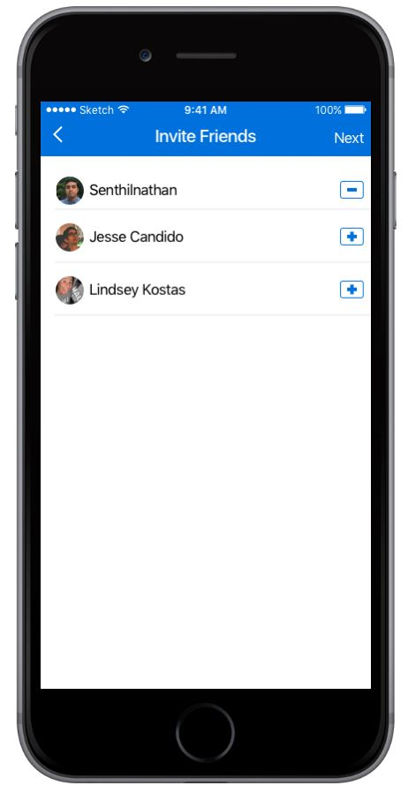
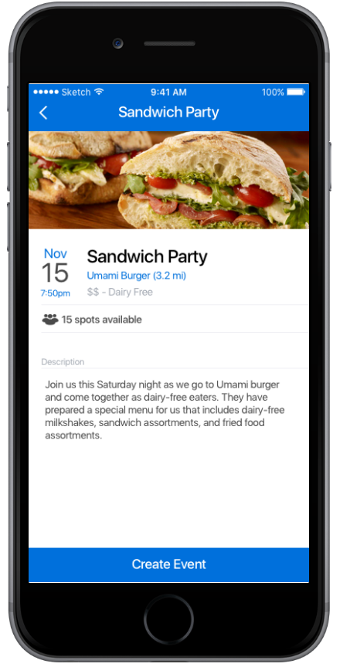
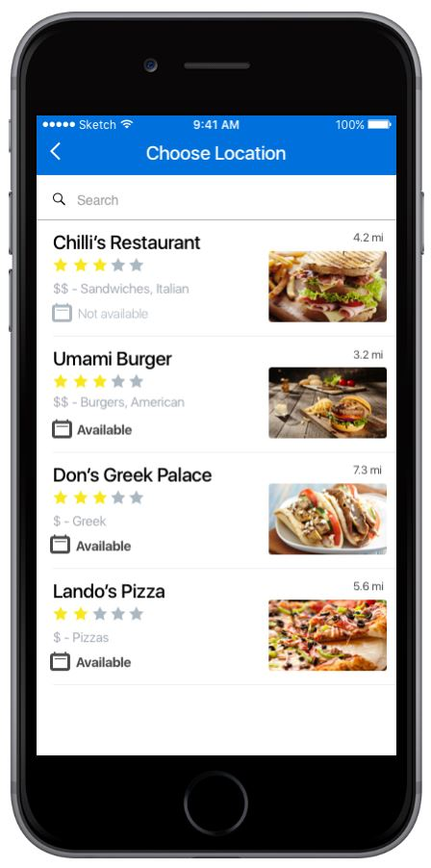
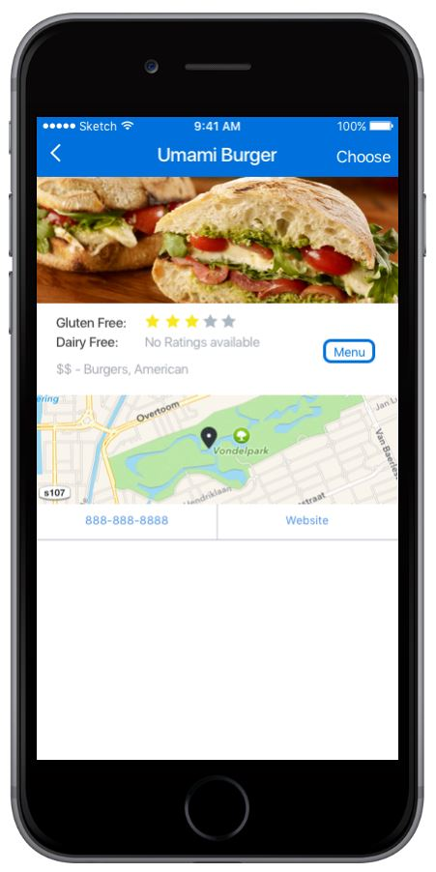
return to event management page
option to invite friends
Enter all fields before pressing next
restriction specific reviews or menu and restaurant website
searchable restaurant list w/ details for event location
review and finalize event
Notes:
Annotated screenshots of prototype

Slide 20
Prototype
Notes:
Prototype Overview

Slide 21

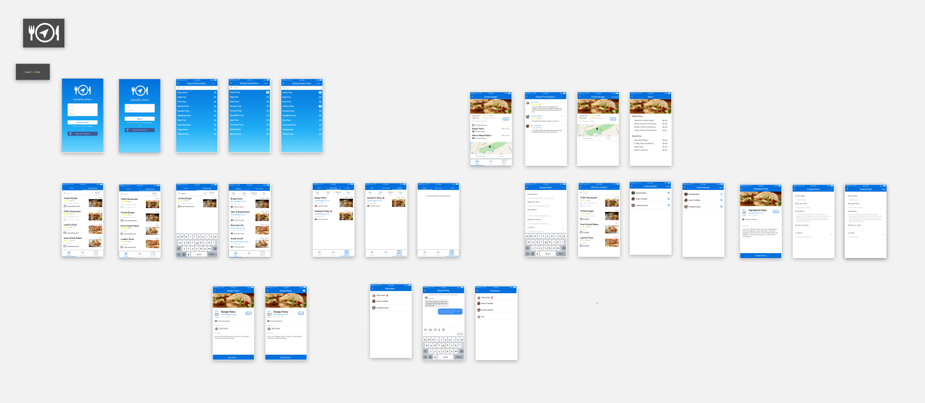
Sketch helped design our UI,
Notes:
Lets get screen shots of our prototype in sketch and marvel for this page. Prototyping Tools - What did you use? - How the tool helped - How the tool did not help
sketch - ios compatible
Marvel - editing is limited, doesnt keep track of the state (problem for back funcionality)

Slide 22
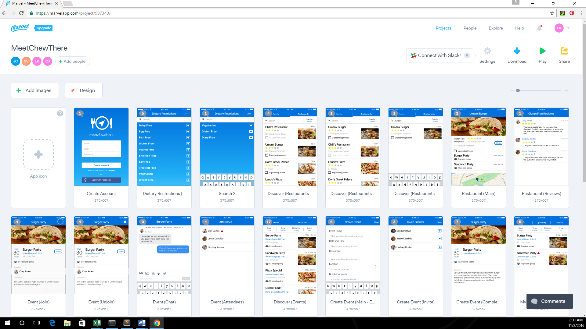

Marvel brought it to life
Notes:
Lets get screen shots of our prototype in sketch and marvel for this page

Slide 23
Limitations & Trade-Offs
Only 1 event and 1 restaurant support “full” functionality
Static Content
Typing
Scrolling
User updates not always reflected (back buttons)
Non-Functional Features
Filters
Search
Messaging

Slide 24
Pay no attention to the man behind the curtain...
Restriction, Restaurant, and Event Selection
Event creation details
Restaurant typed search
Notes:
This slide refers to the wizard of oz aspects of our prototype - ie the user ultimately gets to make no decisions as their restrictions, what they type into the restaurant search bar, the event they select, and the content of the event they create is all preselected for them

Slide 25
Hard-coded Features
Restaurant List
Restaurant Ratings and Reviews
Events List
Event Group Chat Messages
Other Users
Restrictions List

Slide 26
Prototype
Additional Images

Slide 27
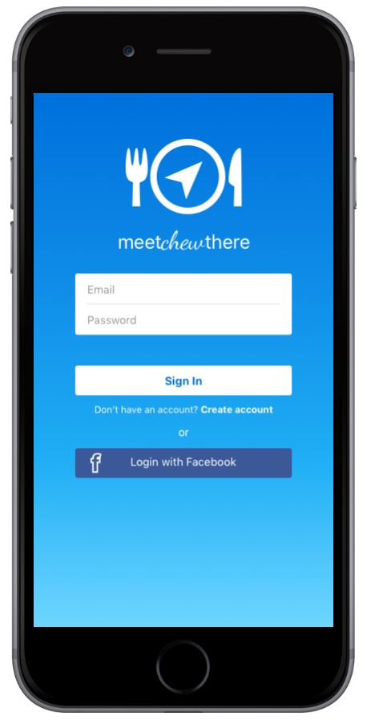
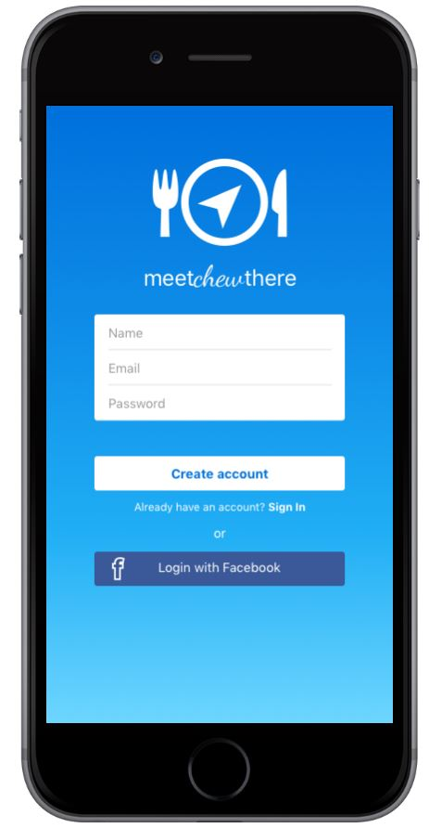
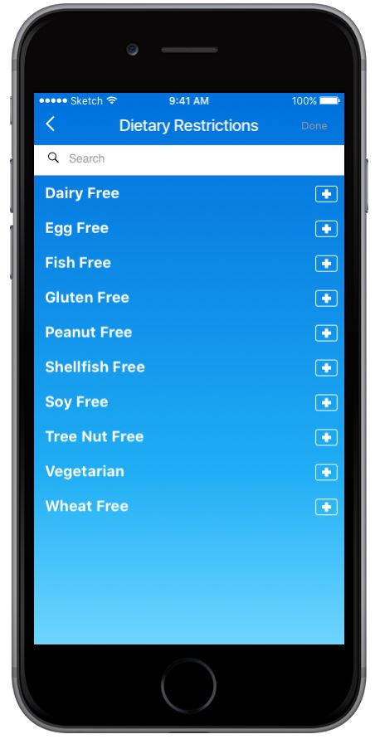
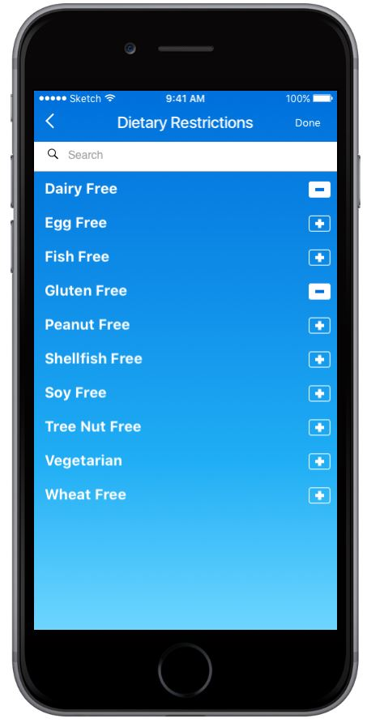
Registration/Sign-In
Login or Signup w/ an easy 2-step process
Search and add dietary restriction(s)
Directed to geographically filtered (based on user’s location during sign up) event feed upon sign in

Slide 28
Home Pages
Search by scroll, typed search, and/or filter
Search by scroll and filters
Tab-bar navigation to toggle between event and restaurant focused searches
only events for user’s restriction
search for events under events tab or see events at a specific restaurant using restaurant tab
Only shown events/restaurants within user’s geographic proximity
<- User directed to Events view upon login/sign-up

Slide 29

Navbar
bottom of almost all screens for convenient navigation
Blue icon indicates current selection
Click Discover to view event/restaurant search
Click New Event to create an event
Click My Events to manage your existing events

Slide 30
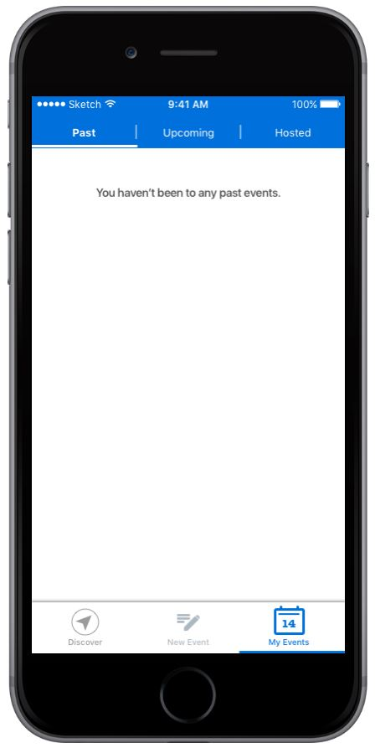
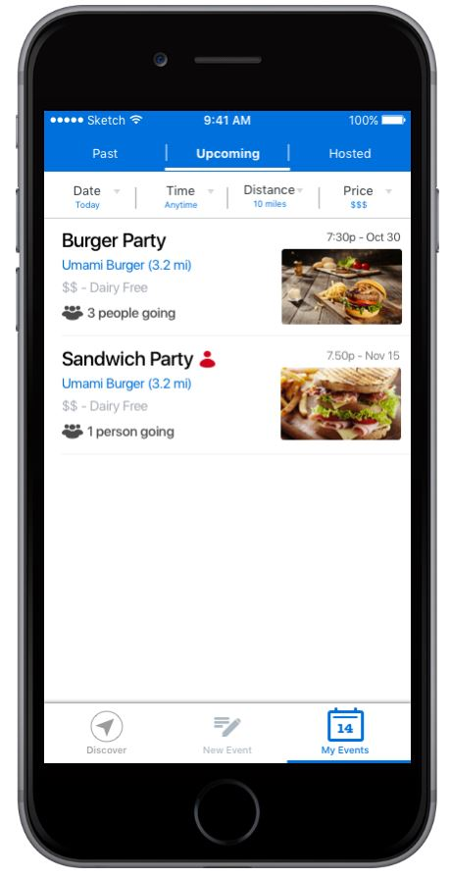
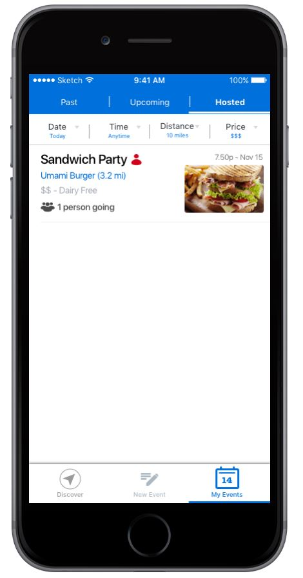
“My Events”
Toggle between past, upcoming and owned events
Search events lists with filters
Past and Upcoming Events show all your events
Hosted shows only user owned events
Figure flags as user owned
View event details
View/Edit your event

Slide 31
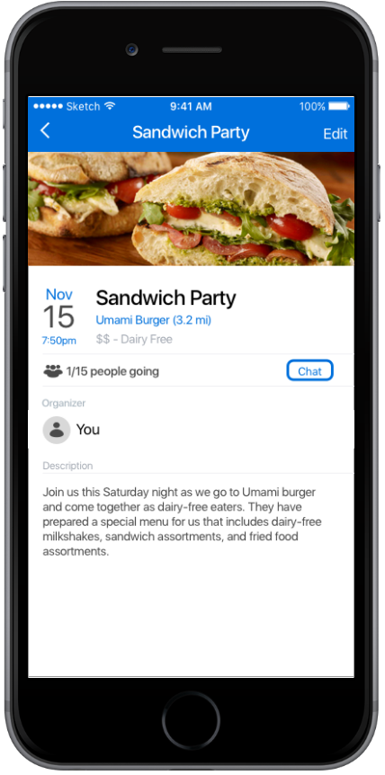
Event Details Pages
Event You Haven’t Joined
Event You Created
Event You Have Joined

Slide 32
Thank You

Slide 33
Index

Slide 34
StoryBoard Sketches

Slide 35
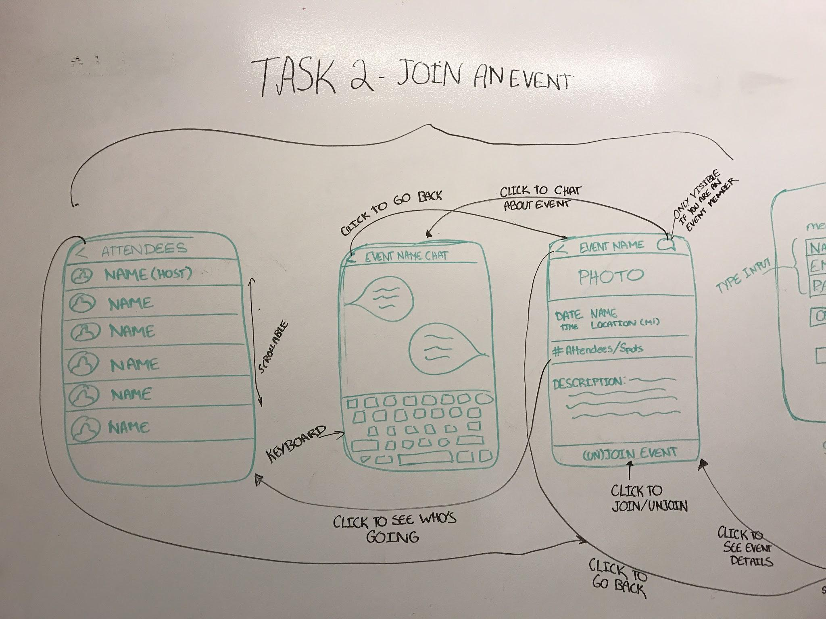
Whole System

Slide 36
Simple Task

Slide 37
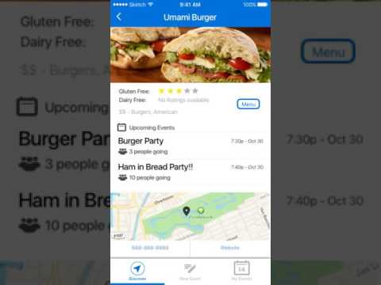
Notes:
Change to being restaurant based. LET FOOD AND FRIENDS FIND YOU

Slide 38
Moderate Task

Slide 39


Slide 40
Complex Task

Slide 41
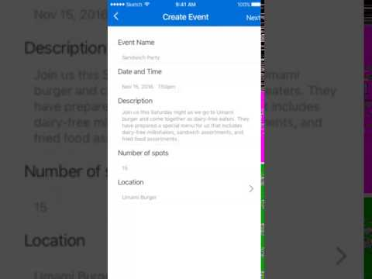

Slide 42


